Slide 1
Research on Facial Expression Recognition
Teammate: Run Zhang
Date: 2021/5/16

Slide 2
Project Direction
Inspired by facial recognition technology, apply machine learning in the field of facial expression recognition.
Build Convolutional Neural Network structure
Add CenterLoss Function to enhance the performance

Slide 3



Dataset
Extended Cohn-Kanade Dataset (CK+)
123 Subjects with facial images in seven emotions：
Anger, contempt, disgust, fear, happy, sadness and surprise
Anger
Happy
Surprise

Slide 4
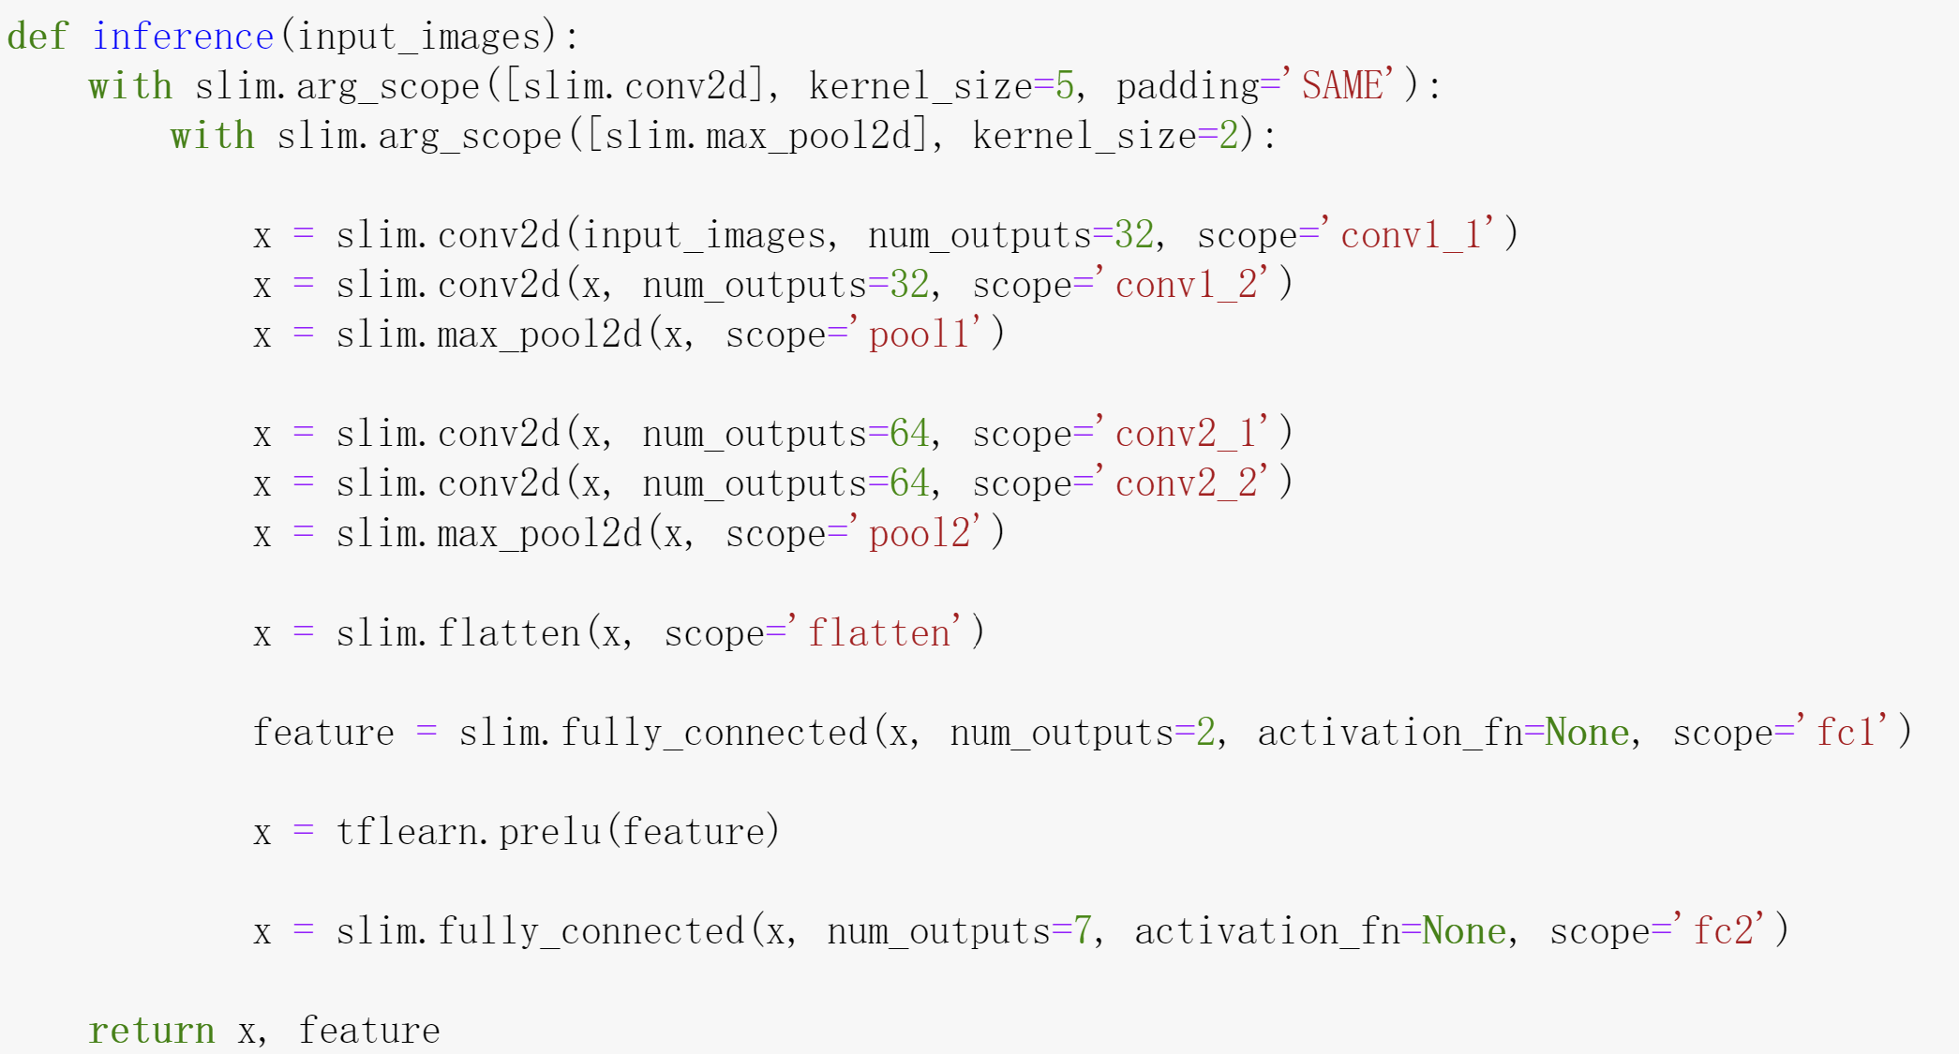
CNN Structure
The CNN structure combines with
two convolutional layers
two pooling layers
two fully connection layers

Slide 5

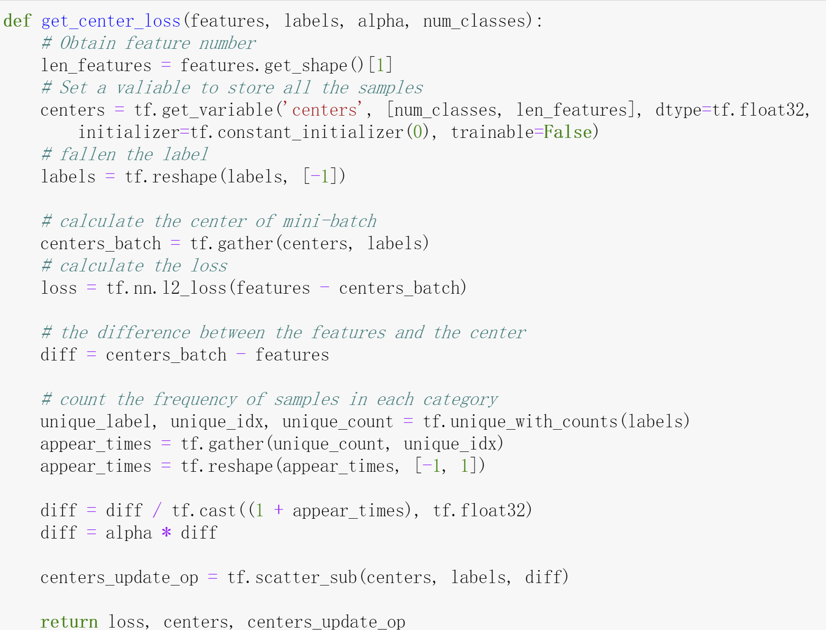
Center Loss Function
Center Loss function minimizes the distance within the same cluster.

Slide 6
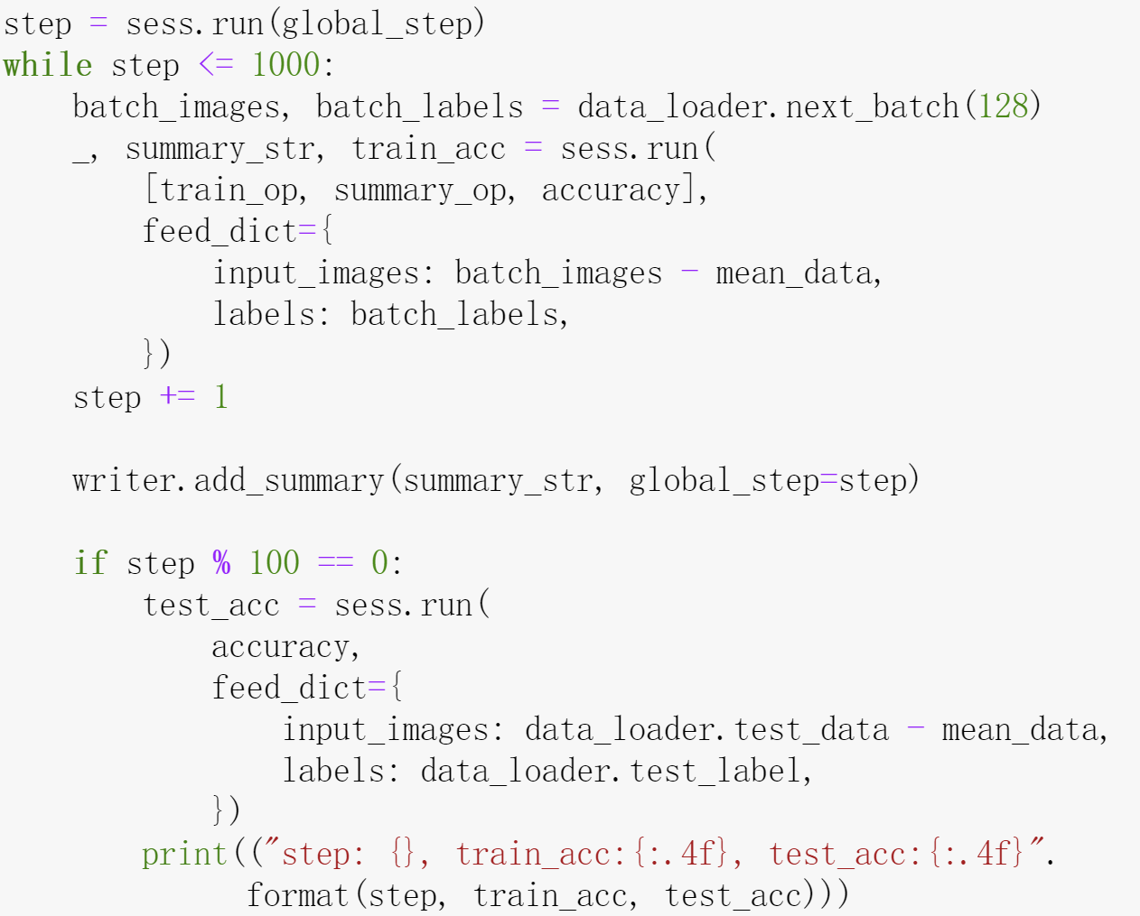
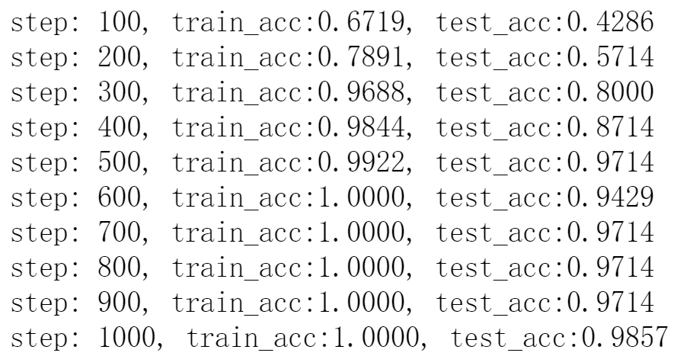
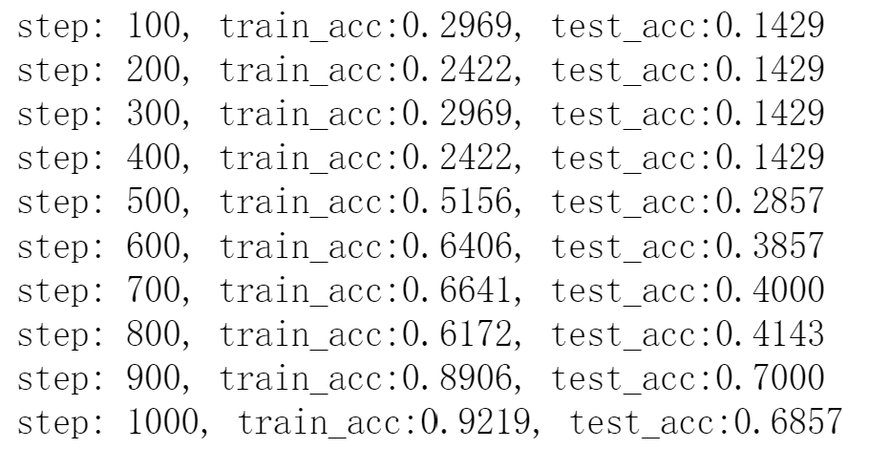
Training Process
Without CenterLoss
With CenterLoss

Slide 7
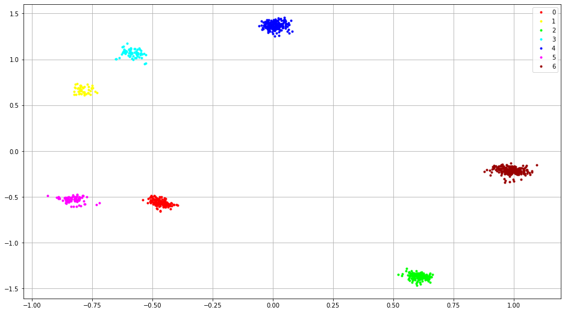
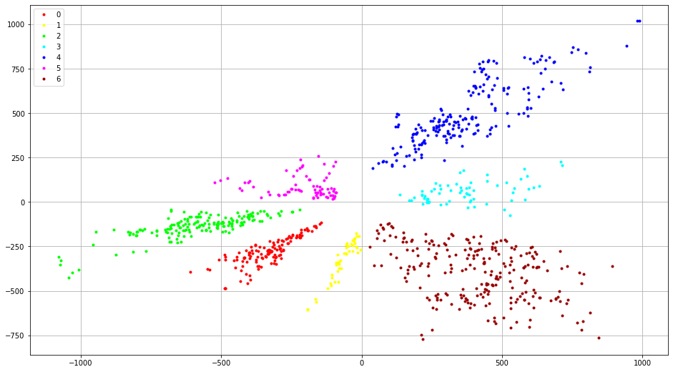
Visualize the Training Result
With CenterLoss
Without CenterLoss

Slide 8
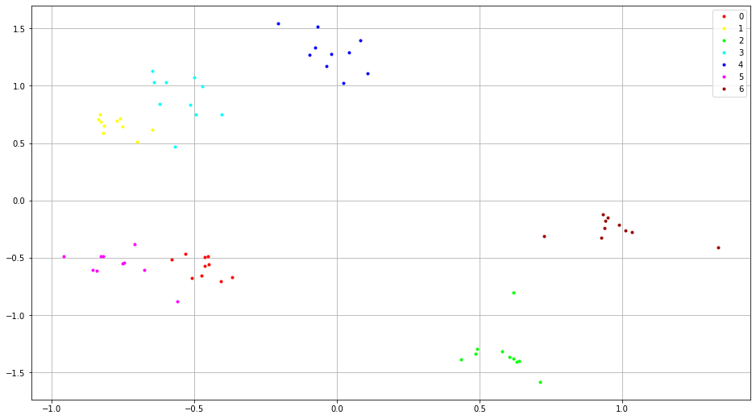
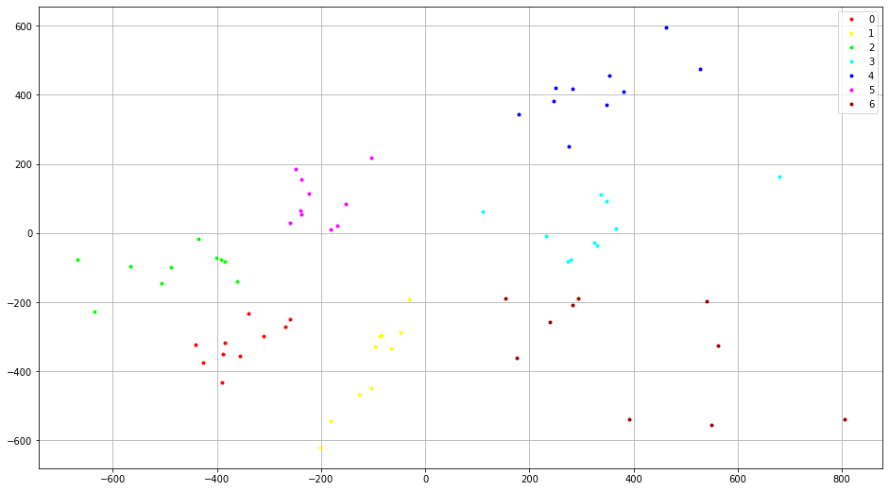
Visualize the Testing Result
With CenterLoss
Without CenterLoss

Slide 9
Thanks for watching
Reference
Y. Sun, X. Wang, and X. Tang. Deep learning face representation by joint identificationverification. Technical report, arXiv:1406.4773, 2014.
Yandong Wen, Kaipeng Zhang, Zhifeng Li, and Yu Qiao. A discriminative feature learning approach for deep face recognition. In ECCV, 2016.
S. Li and W. Deng, “Deep facial expression recognition: A survey,” CoRR, vol. abs/1804.08348, Jun. 2018
https://github.com/WuJie1010/Facial-Expression-Recognition.Pytorch
https://github.com/EncodeTS/TensorFlow_Center_Loss

